Slide 1
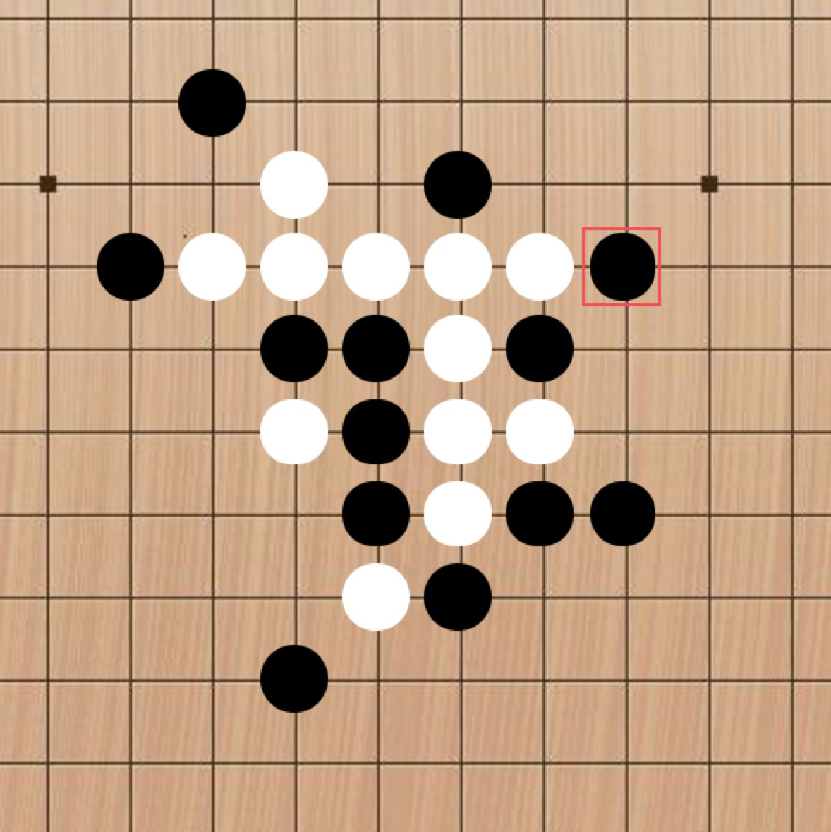
Based on the C # Gobang Development and Design
YAN XU
Yan.xu2021@outlook.com
31JAN2021

Slide 2
Abstract
With the faster pace of life, the game has become an indispensable part of life, which not only makes fun, relax the mood, but also to the development of human intelligence.
Software Development Life Cycle (SDLC): Requirements\Design\Implementation\Testing\Support
Software Process Models: Incremental development\Iterative development\Spiral models\Waterfall\Rational Unified Process\Agile processes
Let us start to develop a casual game called Gobang!

Slide 3
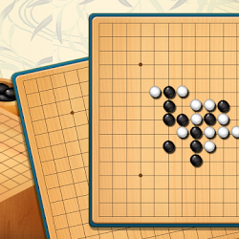
What is Gobang game
Gobang is a two-player abstract strategy game generally played with Go pieces on a 19*19 Go board. Also know by the name Five in a Row.
It is a traditional oriental game, originally from China.
Black plays first, and players alternate in placing a stone of their color on an empty intersection.
The winner is the first player to get an unbroken row of five stones horizontally, vertically, or diagonally.

Slide 4
Game Experience
Question? Share? Brainstorming!

Slide 5
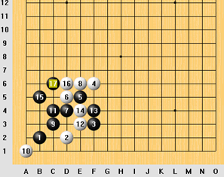
Gaming!
Always block the opponents four and then think. Don't spend time to think what this four would change in the position, if you want to continue the game, you have only one move to play. You can think about the position after the move.
Think about future development of the game and find move that will help in future position.
Example: how to block better. After blacks 17 white has two options to play. It can either play 18-c5 or 18c-7.

Slide 6

Evaluate!

Slide 7
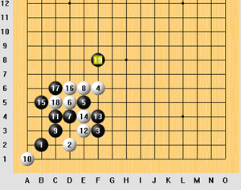
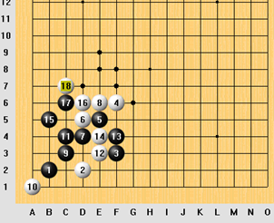
Wrong black. 18-c5 might seem like an obvious move. But from strategic point of view, it's horrible move because it helps black occupy the space in the middle. After 19-f8 the situation doesn’t look like white advantage.
Right block: 18-c7.Much better move which allows white to spread its possibilities in the middle and yet keeps black from winning in the corner.
If black plays for example 19-d7,white can still control the situation and build a strong position in the upper part of the board where black has no moves.

Slide 8
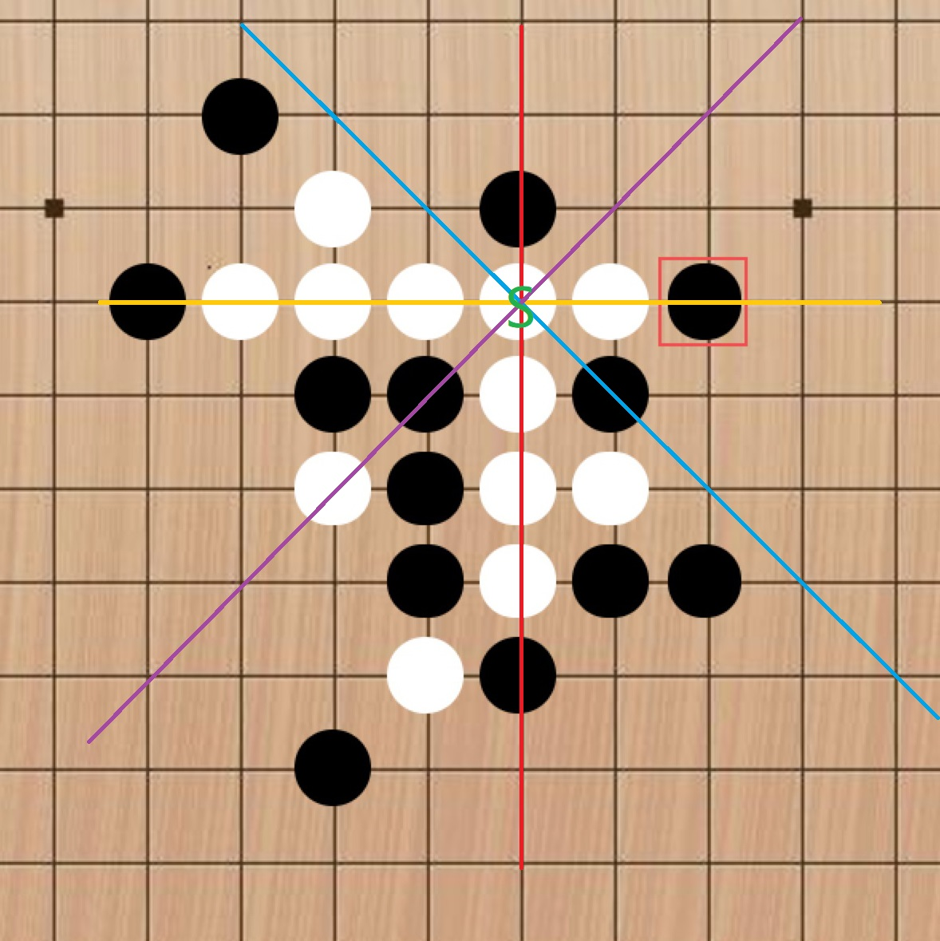
Algorithm behind Gobang!
When a chess piece is placed (the corresponding chessboard should have a coordinate), it should be judged whether the horizontal, horizontal, vertical or diagonal (left and right diagonal) of the chess piece meets the number of consecutive chess pieces.
If the number is greater than or equal to 5, you should make a judgment every time you play a chess piece, and you should perform the traversal algorithm in 4 major directions (horizontal, vertical, diagonal left, diagonal right) each time.
In the picture, there are 3 consecutive black chesses, plus one on the right (the middle one has not been played yet, use S for the convenience of presentation). Obviously, if the black chess is played now, S is the best position. For computers, how should we use algorithms to make the computer understand that it can win if placed in the s position.
After placing the S position, a counting flag count should be set to determine whether the number of chess pieces in a certain direction is greater than 5, that is, whether count>=5 holds. In the four major directions in the figure, count should be set to 1 before each direction is traversed;

Slide 9
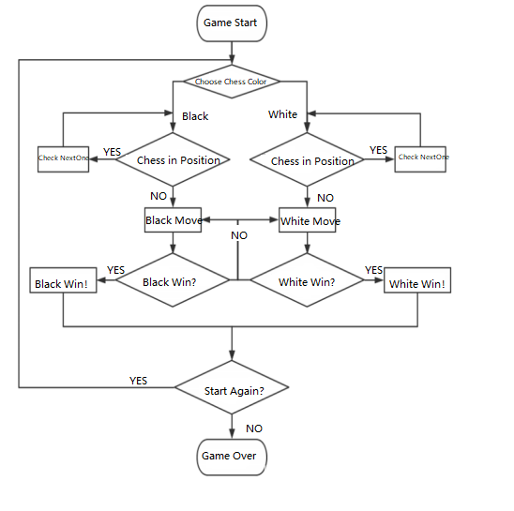

Slide 10

Thank you
Any comments or suggestion for this project?

